Slide 1
Inferring Graphs From Data
Ivan Brugere
University of Illinois at Chicago

Slide 2
“Why?” : Problem Scope
Thresholding, rule-based
  “An edge exists if more than…”
Temporal data
  Sampling rate and historical window
Multi-relational, multi-modal data
  User-product purchases/product co-view graphs
  User message-graph/user friendship graph
Missing Nodes or Interactions:
  Network completion problems
Appropriate ML on our graph
  Is our ML robust to graph samples/all the above
Aim: end-to-end learning from underlying data

Slide 3
Full details
Brugere, I., Gallagher, B., & Berger-Wolf, T. Y. (2018). Network Structure Inference, a Survey: Motivations, Methods, and Applications. ACM Computing Surveys (CSUR), 51(2), 24.

Slide 4
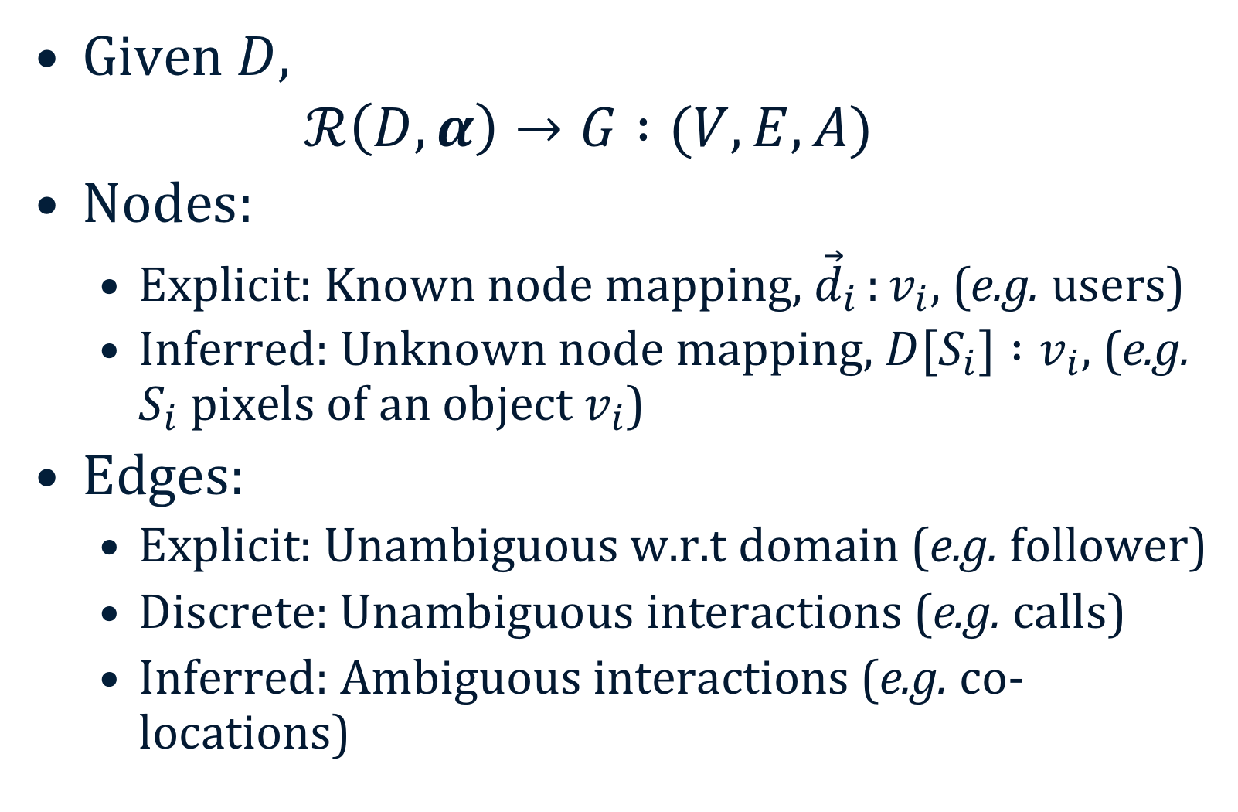
Graph definition
Given $D,$
  $$ℛ\left(D, α\right)→G :(V, E, A)$$
Nodes:
  Explicit: Known node mapping, ${\vec{d}}_{i }:v_{i}$, (e.g. users)
  Inferred: Unknown node mapping, $D[S_{i}] :v_{i}$, (e.g. $S_{i}$ pixels of an object $v_{i}$)
Edges:
  Explicit: Unambiguous w.r.t domain (e.g. follower)
  Discrete: Unambiguous interactions (e.g. calls)
  Inferred: Ambiguous interactions (e.g. co-locations)

Slide 5
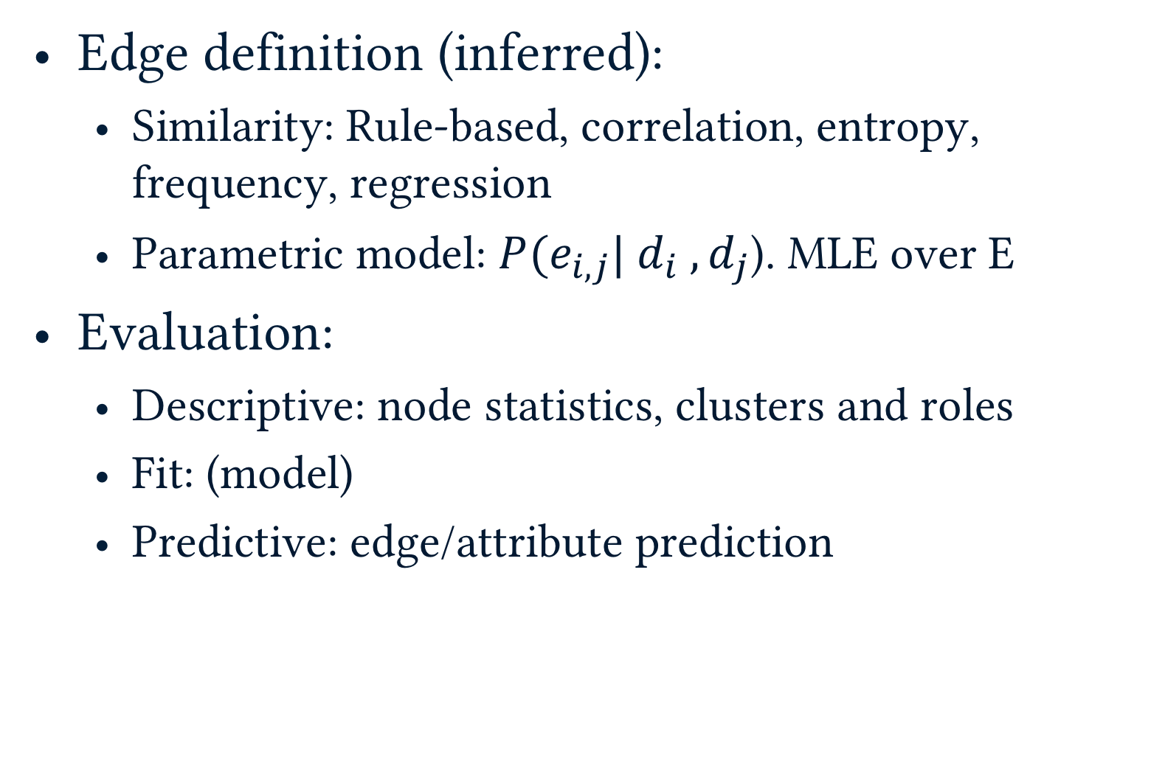
Graph definition
Edge definition (inferred):
  Similarity: Rule-based, correlation, entropy, frequency, regression
  Parametric model: $P(e_{i,j}| d_{i} ,d_{j}$). MLE over E
Evaluation:
  Descriptive: node statistics, clusters and roles
  Fit: (model)
  Predictive: edge/attribute prediction

Slide 6
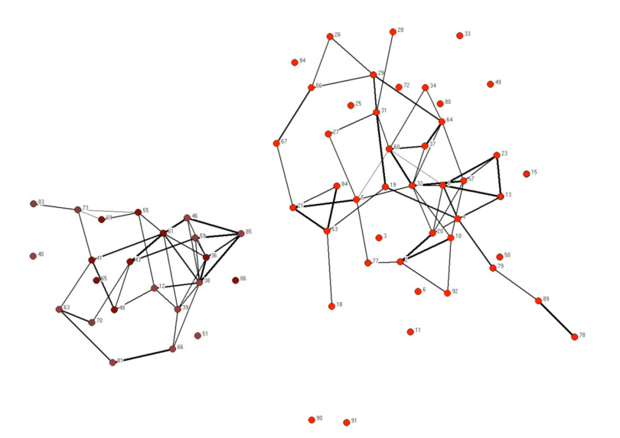
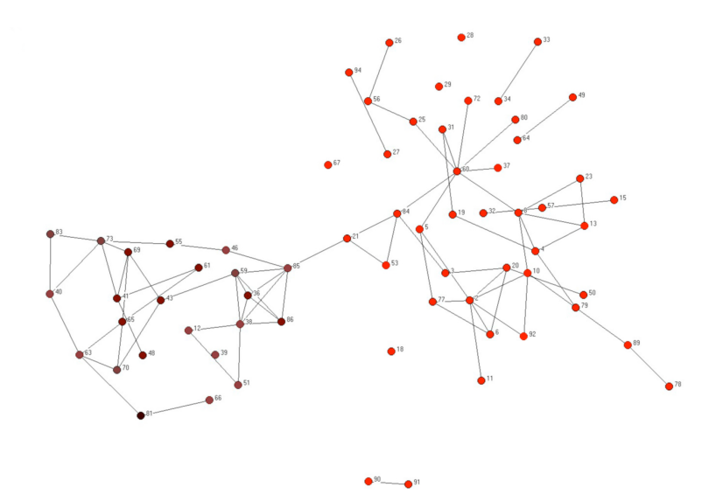
A light example
A Reality Mining graph inferred from mobile phone users (nodes)
Edges defined by PCA on calls (discrete) and Bluetooth (inferred) interactions
Evaluated against survey data of ground-truth friendships, (right, looks OK!)
Inferred
Survey Friendships
Eagle, N., Pentland, A. S., & Lazer, D. (2009). Inferring friendship network structure by using mobile phone data. Proc. of the National Academy of Sciences

Slide 7
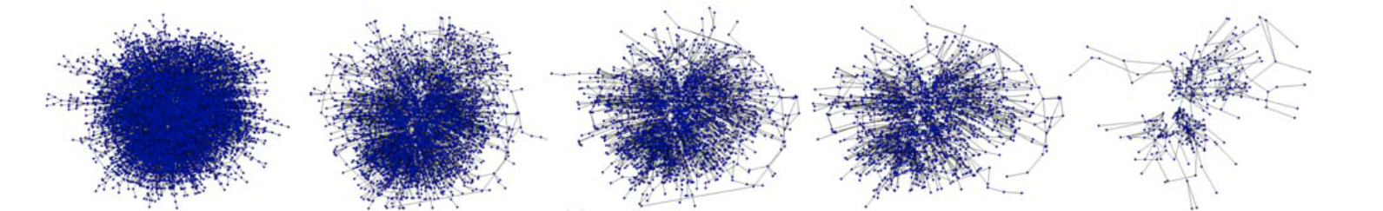
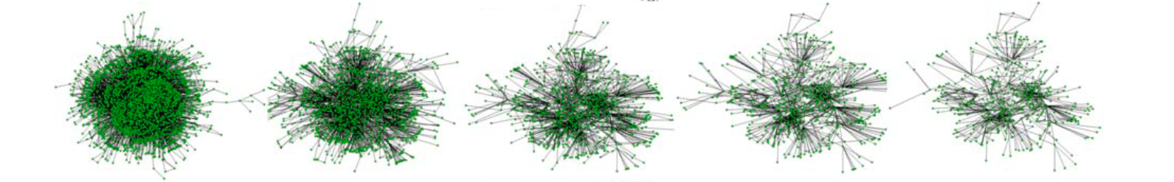
Predictive Evaluation: Thresholding
Varying interaction thresholds (e.g. # of emails) creates different graphs
Various graphs are evaluated on their predictive ability (e.g. role prediction)
University Email
Enron Email
De Choudhury, M et al. (2010). Inferring relevant social networks from interpersonal communication. In Proc. of the 19th WWW Conference

Slide 8
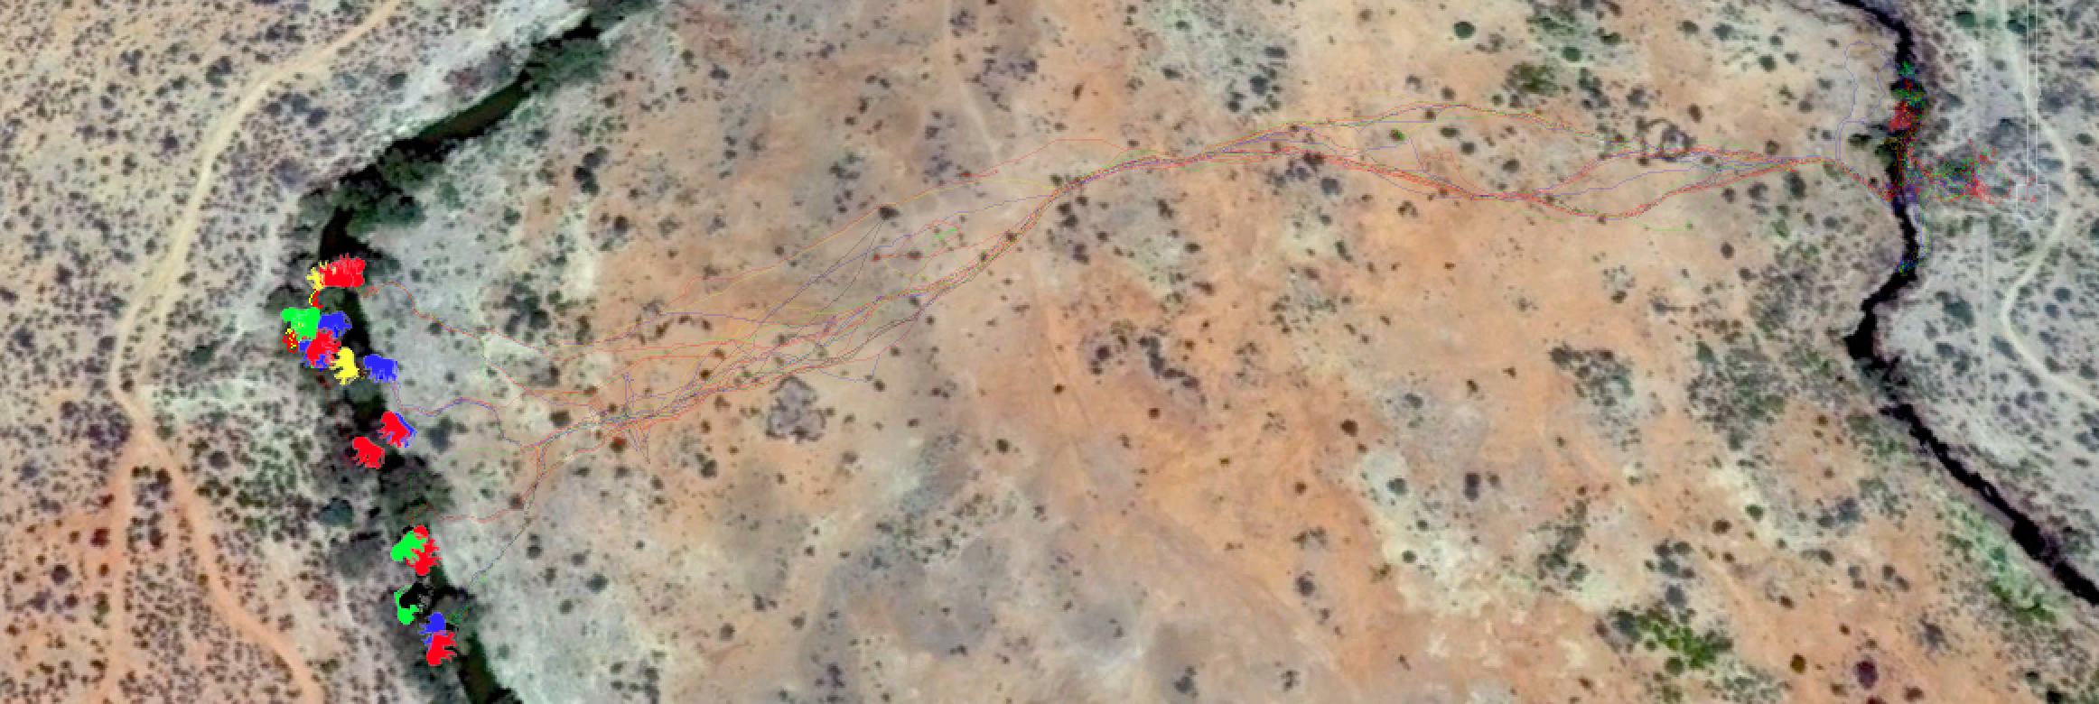
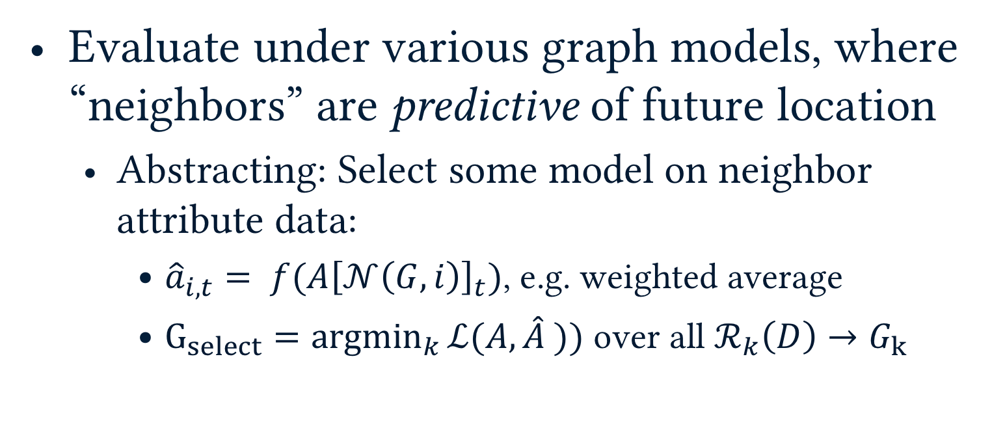
Predictive Evaluation: Inference
Evaluate under various graph models, where “neighbors” are predictive of future location
  Abstracting: Select some model on neighbor attribute data:
    ${\hat{a}}_{i,t}= f(A{\left[𝒩\left(G, i\right)\right]}_{t})$, e.g. weighted average
    $G_{select}=\underset{k}{argmin}{ℒ(A, \hat{A} )})$ over all $ℛ_{k}\left(D\right)→G_{k}$
Farine, D. R., Strandburg-Peshkin, A., Berger-Wolf, T., Ziebart, B., Brugere, I., Li, J., & Crofoot, M. C. (2016). Both nearest neighbours and long-term affiliates predict individual locations during collective movement in wild baboons. Nature Scientific Reports.
Notes:
MENTION: Our work: Nature Scientific Reports
Left (Association Network), Right (Affiliation Network)
Results:
Dunbar number: 4–6 individuals
Time scale: >10 minutes, affiliation networks better

Slide 9
Hypotheses: Predictive Evaluation
Aggregating over time allows testing of hypotheses about association stability
  How many neighbors are predictive?
    Between 4-6 (of N=26).
  Do individuals tend to long-term affiliations?
    Yes, after ~10 minutes
Short-term Associations
Long-term Affiliations

Slide 10
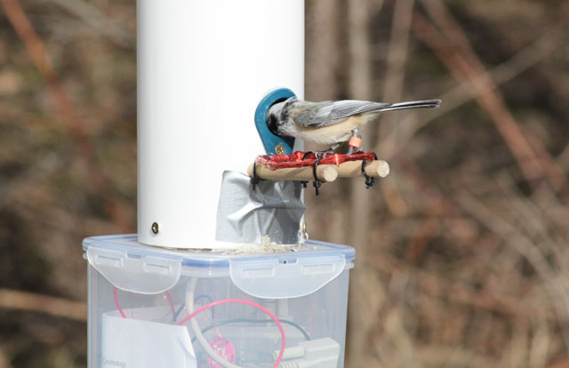
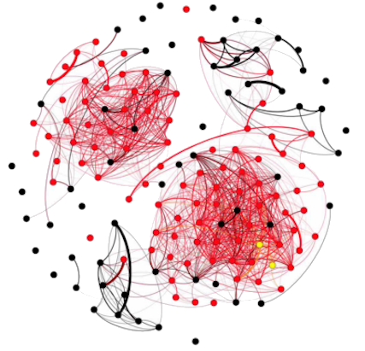
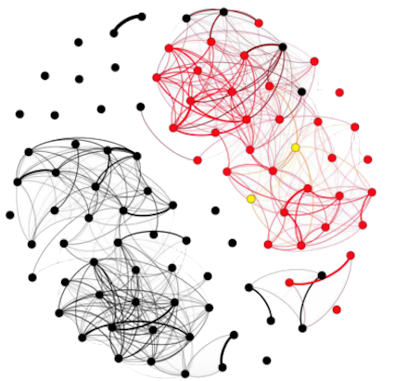
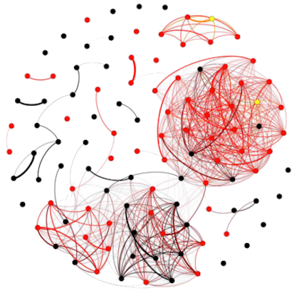
Experimental Design w/ Inferred Graph
Measuring knowledge-transfer on instrumented populations
Trained birds (green), (inferred) interacting solvers (red)
Aplin, L. et al. (2015). Experimentally induced innovations lead to persistent culture via conformity in wild birds. Nature.
Notes:
RFID over different populations

Slide 11
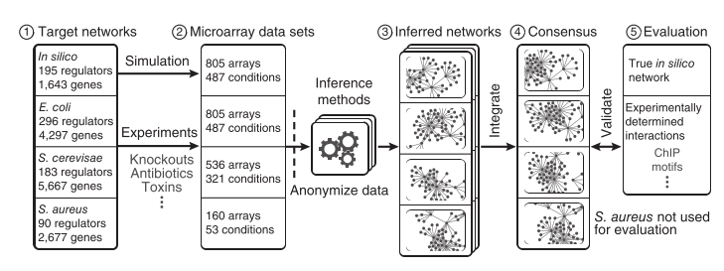
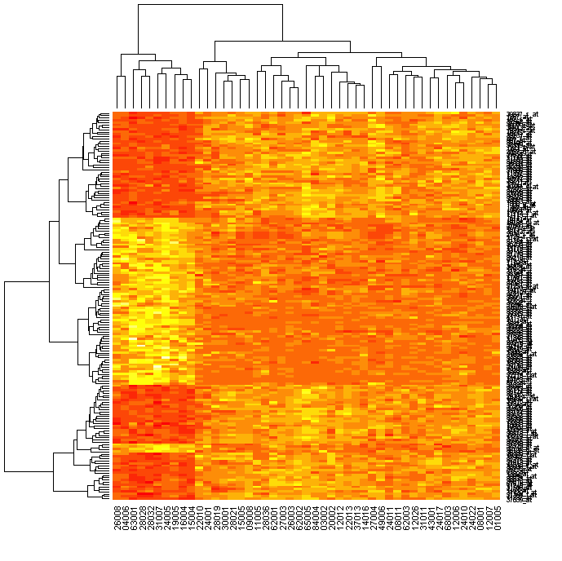
A heavy end-to-end example
Large-scale ensemble: evaluation of synthetic and experimentally-verified gene regulation
To discover unknown regulation candidates
Gene
Sample
Marbach, D., et al. (2012). Wisdom of crowds for robust gene network inference. Nature methods
Notes:
PAUSE on survey

Slide 12
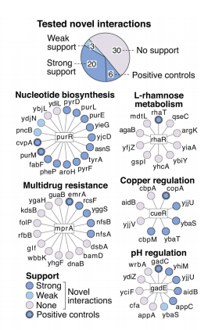
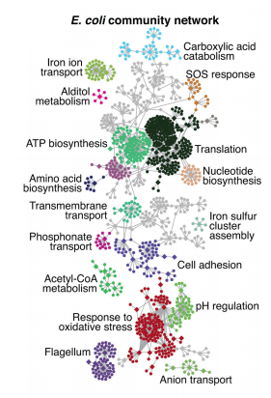
Consensus Network Evaluation

Slide 13
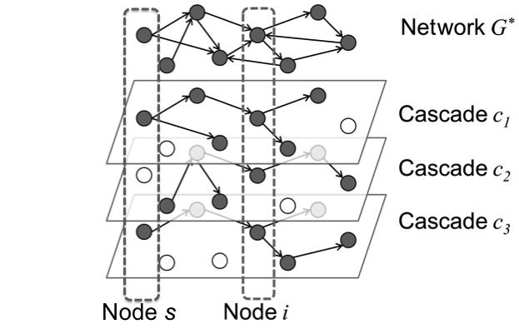

Information Cascades
Reconstruct hidden network from information arrival at nodes
  Parametric model: $P\left(e_{i,j}\right|{t_{j}−t}_{i})$, or $P\left(T\right|A[T])$
Evaluate: Graph re-inference (induced arrival)
Gomez-Rodriguez, M. et al. (2010). Inferring networks of diffusion and influence. In Proc. of the 16th ACM SIGKDD Conference.

Slide 14
Inferred Information Network

Slide 15
Task-focused Model Selection
Notes:
More details on workflow

Slide 16
Network Models
k-nearest neighbor (KNN)
Threshold (TH)

Slide 17
Network Sampling
Notes:
Many sampling approaches

Slide 18
Tasks
Label prediction (CC)
Link prediction (LP)
Edge features
Non-edge features
Notes:
Two examples of common tasks

Slide 19
Datasets
Notes:
Table should be focus
Generate networks of varying density over models
Network model selection over many label-sets
Last.fm also has a user-defined social network

Slide 20
Precision and Rank Consistency
selected model consistent in each dataset
Worse than random:
Sparse ratings, coarse labels
Mean precision
top-10 models
Precision
Selected model
Consistent models
(Bold)
Consistent ranking
(Bold)
Notes:
1. Networks can do worse than random
2. want: consistency *and* good performance
Different localities selected per dataset/task
Localities > Model for selection
Bold: models in top-10%. (N > 100)

Slide 21
Cross-Task Model Selection
Same task: high stability
Different task: low stability
Average task: low stability
There is no single network for all tasks
The best network depends on the task
Notes:
Better task models don’t matter if we’re using the wrong network.
Cant have general purpose networks

Slide 22
Open questions: end-to-end learning
“One of the hallmarks of deep learning has been its ability to perform complex computations over raw sensory data, such as images and text, yet it is unclear the best ways to convert sensory data into more structured representations like graphs”*
Graph convolution networks (typically on given graphs)
  Recent work on learned graph structure:
    Yang, Z., et al. (2018). GLoMo: Unsupervisedly Learned Relational Graphs as Transferable Representations. arXiv preprint arXiv:1806.05662.
Battaglia, P. W. et al. (2018). Relational inductive biases, deep learning, and graph networks. arXiv preprint arXiv:1806.01261.

Slide 23
“Structure is Everywhere”
Graphs are a convenient representation
  So we tend to see graphs everywhere
But which problems are more natural with different representations?
  Groups*, Streams**, Sets
  And latent spaces
*Tantipathananandh, C., Berger-Wolf, T., & Kempe, D. (2007). A framework for community identification in dynamic social networks. In Proceedings of the 13th ACM SIGKDD international conference on Knowledge discovery and data mining (pp. 717-726). ACM.
**Wu, C. Y., Ahmed, A., Beutel, A., Smola, A. J., & Jing, H. Recurrent recommender networks. In Proceedings of the tenth ACM international conference on web search and data mining (pp. 495-503). ACM.
**Koutra, D., Shah, N., Vogelstein, J. T., Gallagher, B., & Faloutsos, C. (2016). D elta C on: principled massive-graph similarity function with attribution. ACM Transactions on Knowledge Discovery from Data (TKDD), 10(3), 28.

Slide 24
Best practices
Publish underlying data
Link back to underlying data in graph construction
Give fully specified parameters
SNAP does all the above to varying degrees
  Subsequent work studies “the [dataset] graph”
Do sensitivity analysis over graph parameters
Graph parameters are model parameters

